Slide 1
MPC Formulation
Notes:
notes

Slide 2
Cell Level – Objective Function
Relative error
Needs added weights

Slide 3
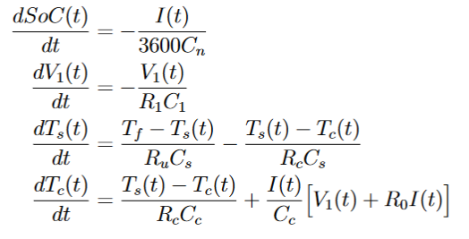
Cell Level - Constraints
State equations
State of Charge
Surface and Core Temperature
Current

Slide 4
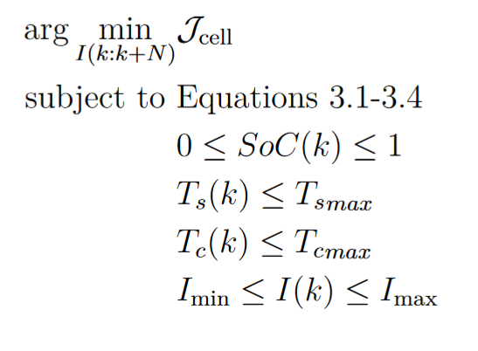
Cell Level – Formulation
Maximum safe temp?
Current limits – Stena?

Slide 5
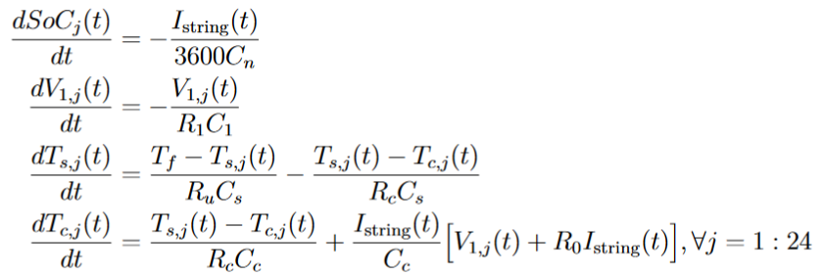
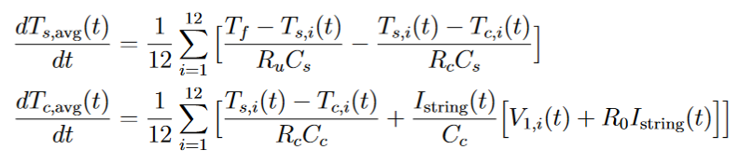

Module Level - Model

Slide 6
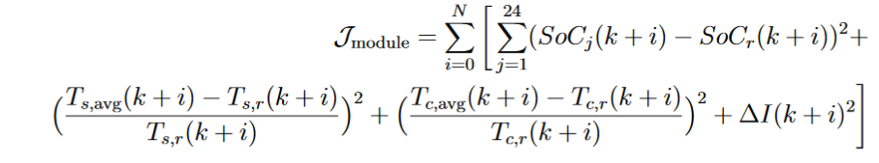
Module Level – Objective Function
Lower computational complexity
Risk of missing information in single cells when averaging out

Slide 7
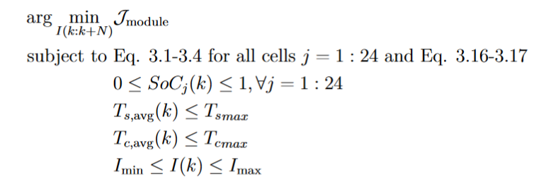
Module Level - Constraints
Similar to the cell level
Constraints on temperature average, not individual cells

Slide 8
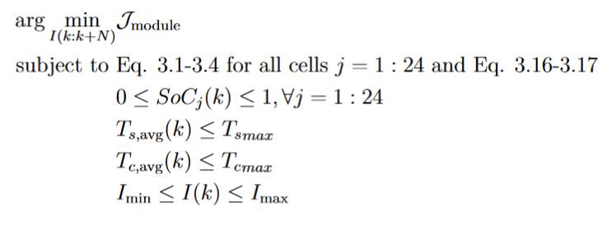
Module Level - Formulation

Slide 9


